Slide 1
Midterm exam
劉泰佑 – C100E030

Slide 2
What things we need to create this project?
Arduino Uno – main control board
Bread Board – plug and play pcb
DHT22 Sensor – humidity and temperature sensor
Photoresistor Sensor – light sensor
LED
Resistor x2
Jumper Cable x8
Pin Header x4
Visual Studio
Arduino IDE

Slide 3
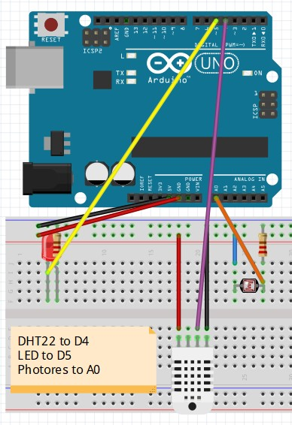
1. Prepare the devices as diagram

Slide 4
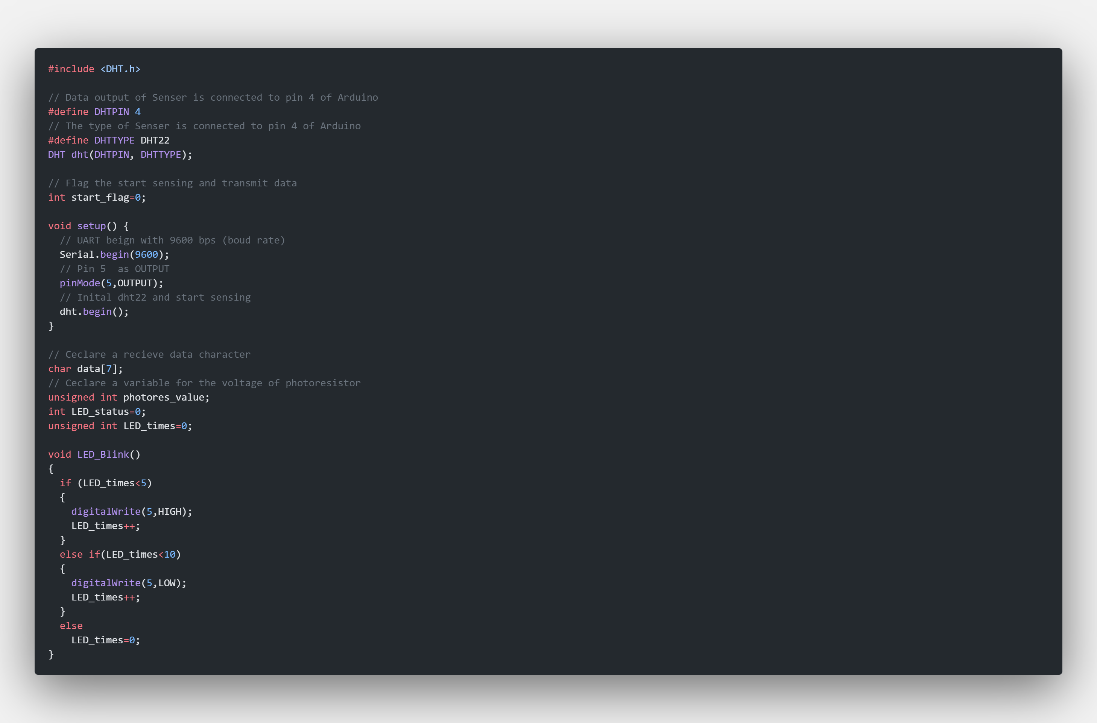
2. Prepare the Arduino Code and flash

Slide 5
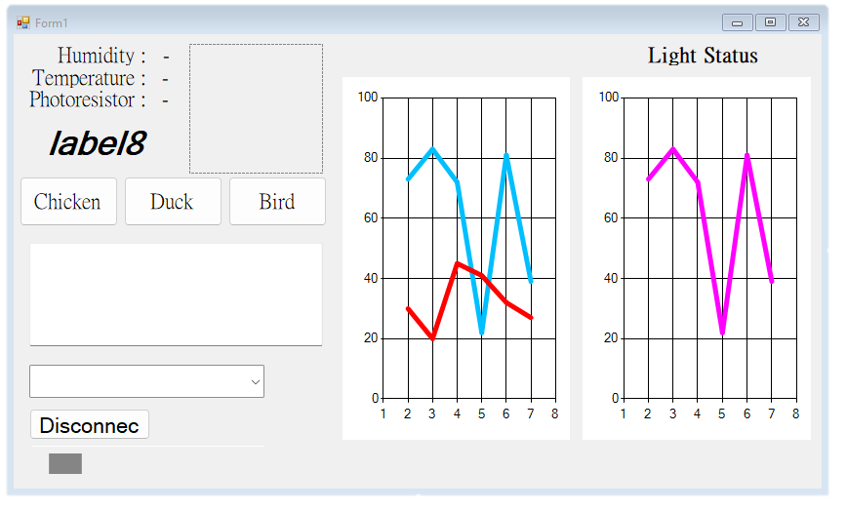
2. Prepare the Visual Studio form design

Slide 6
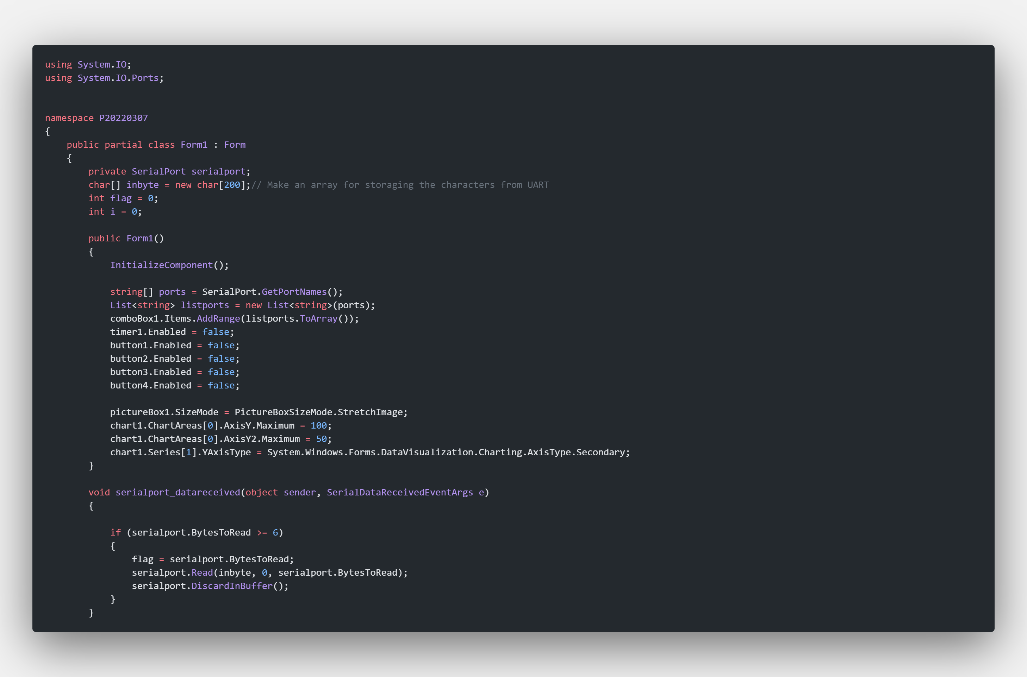
3. Prepare the Visual Studio codes and run

Slide 7

Next : Testing

Slide 8
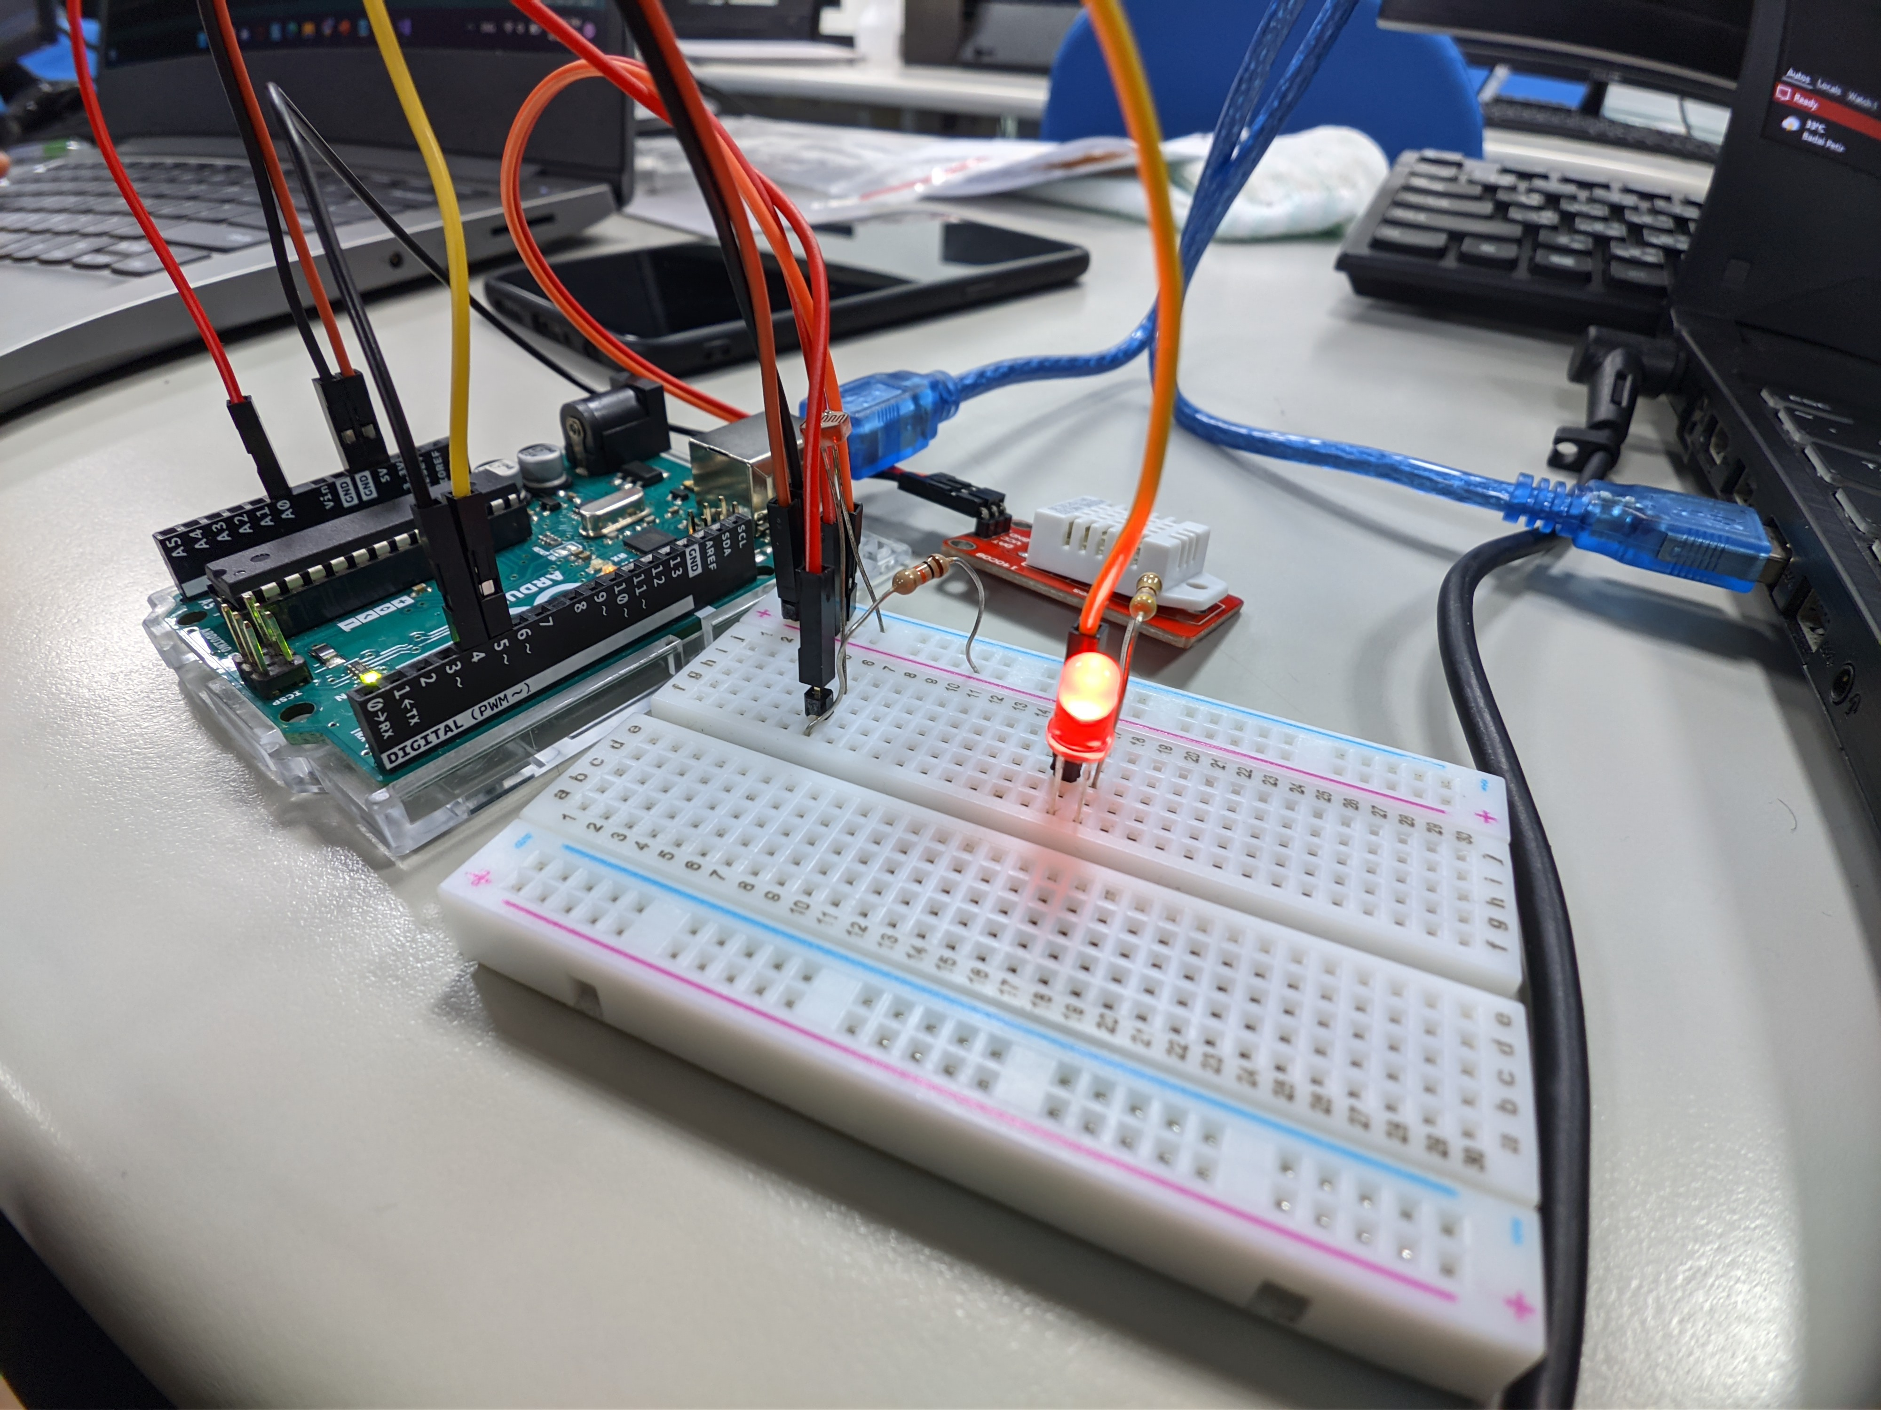
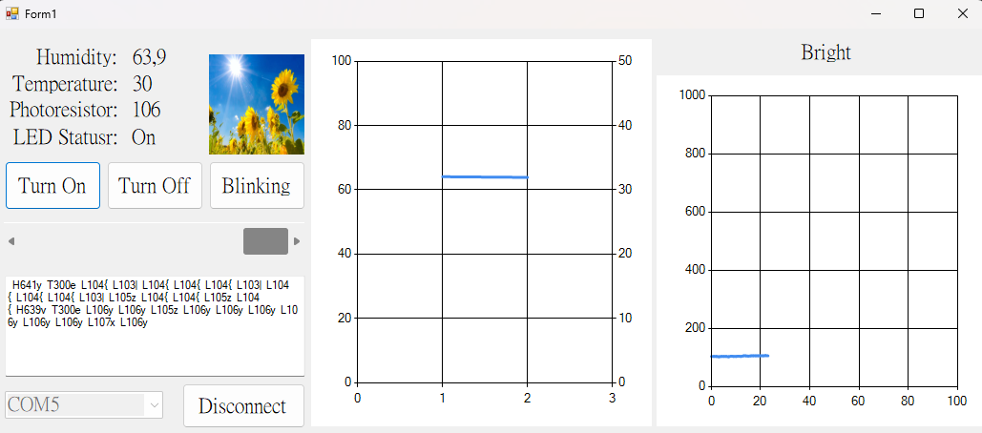
Test led button on
Indicator : led turns on

Slide 9
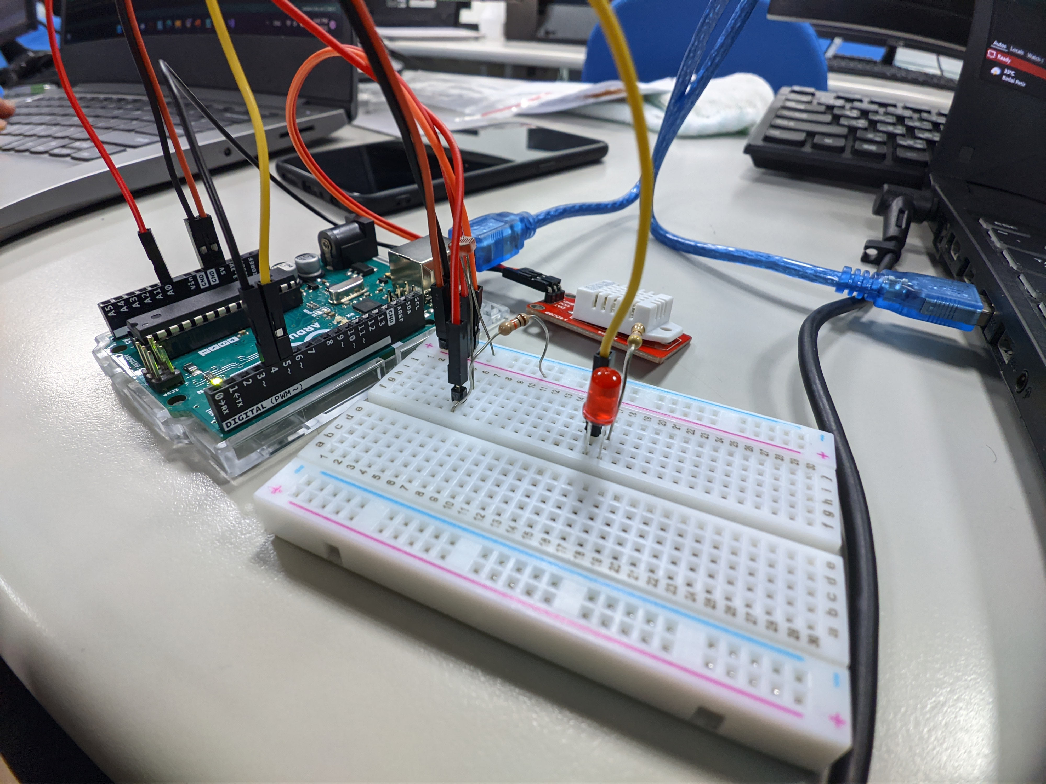
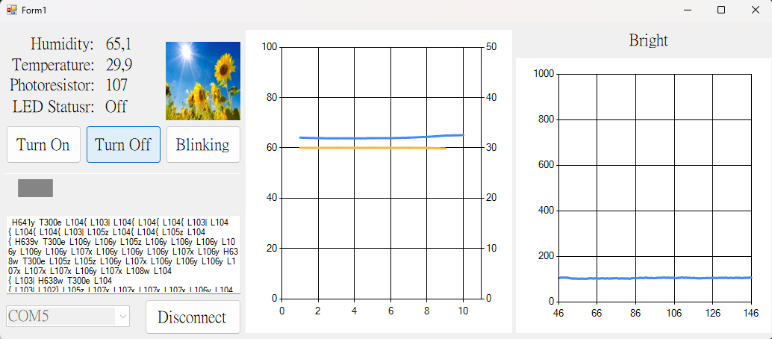
Test led button off
Indicator : led turns off

Slide 10
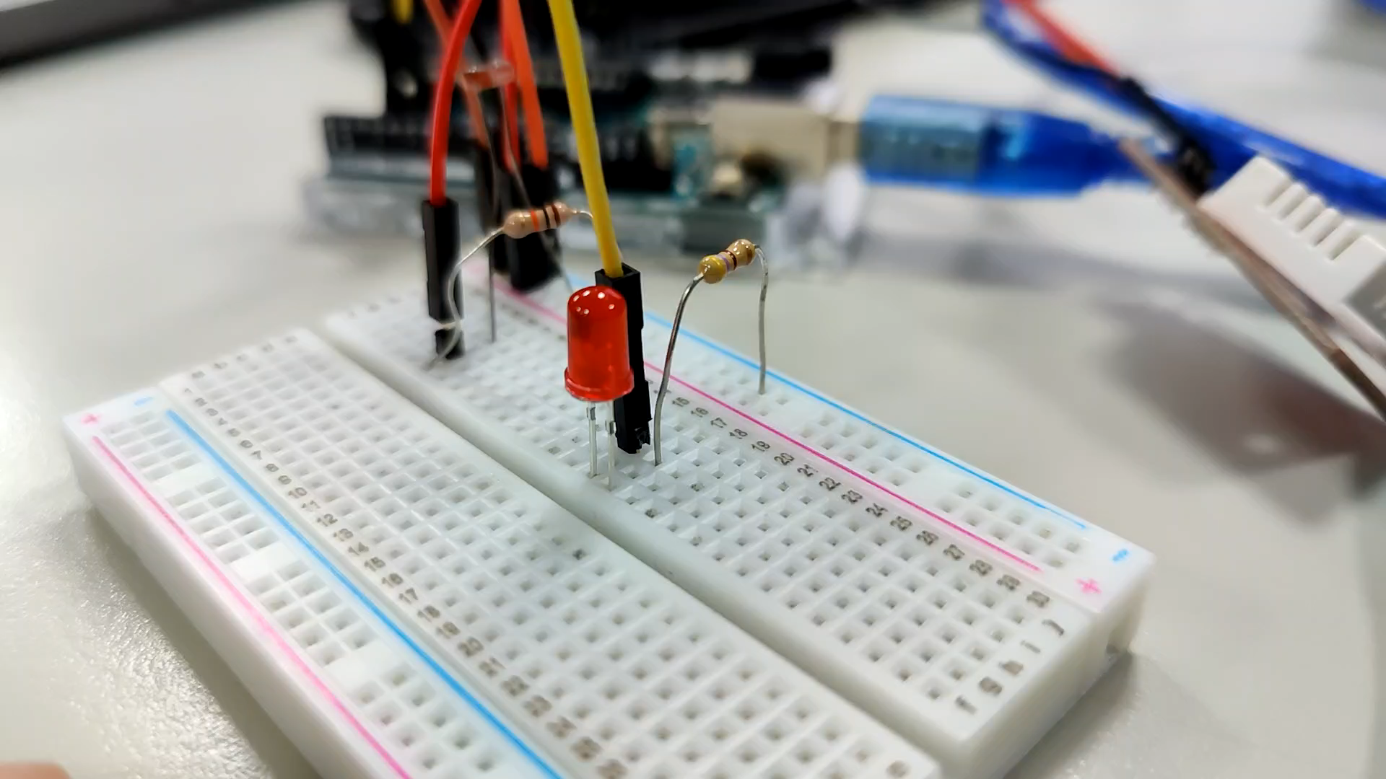
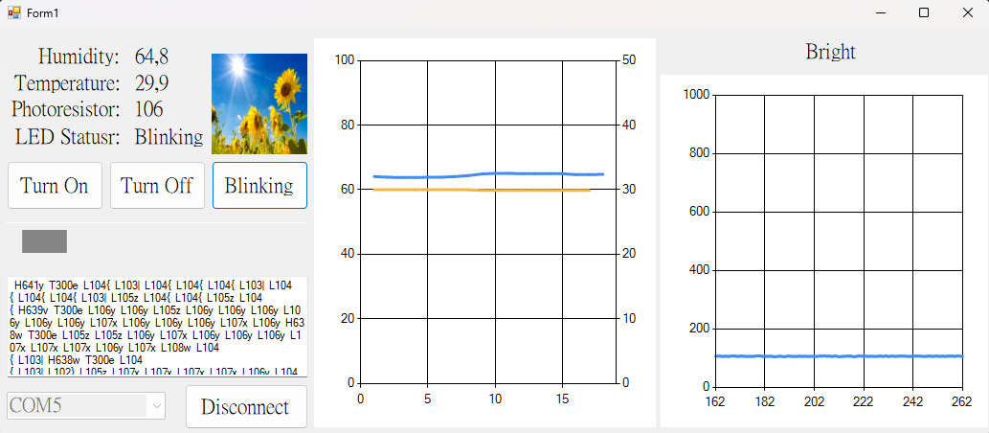
Test led blinking
Indicator : led turns blink (video)

Slide 11
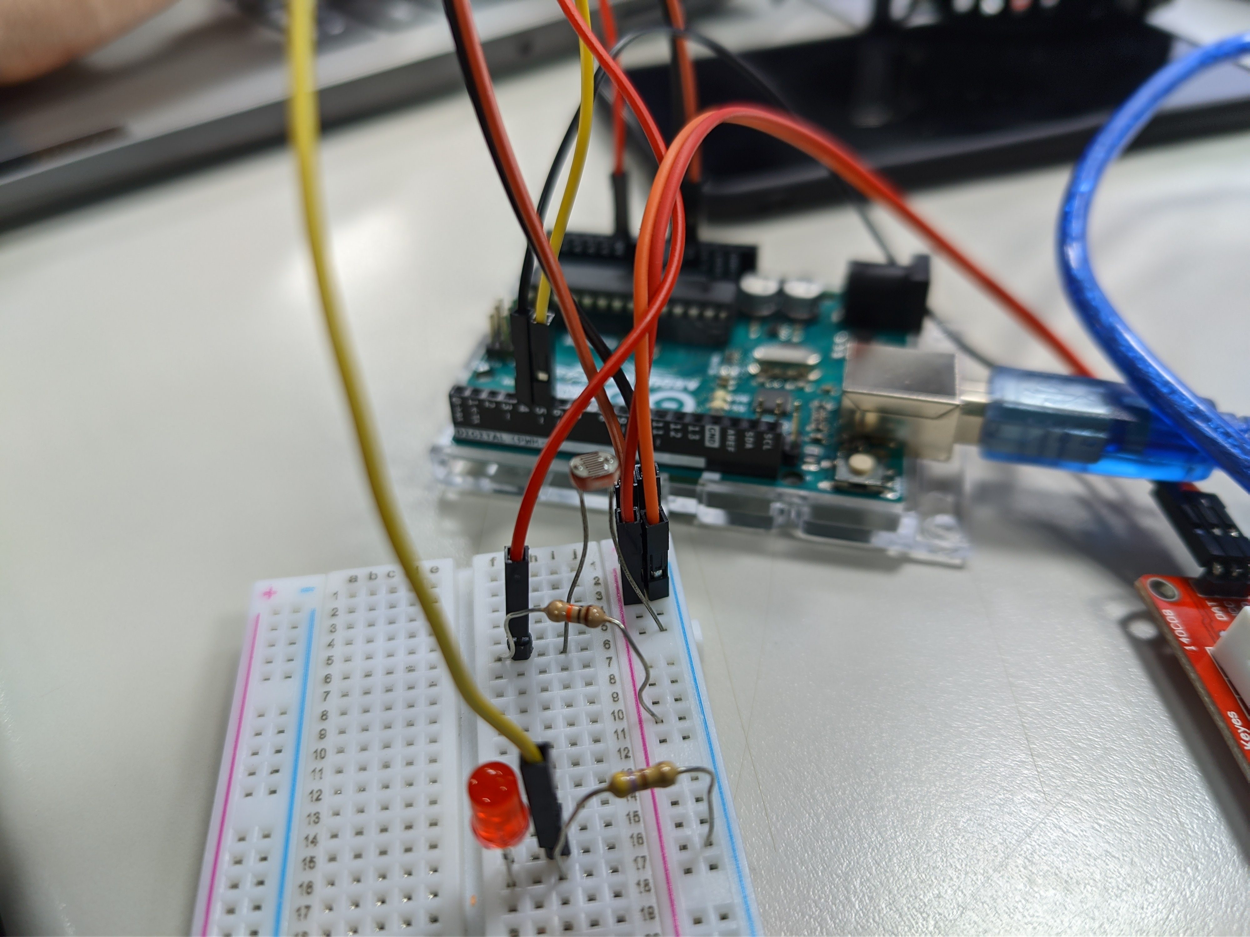
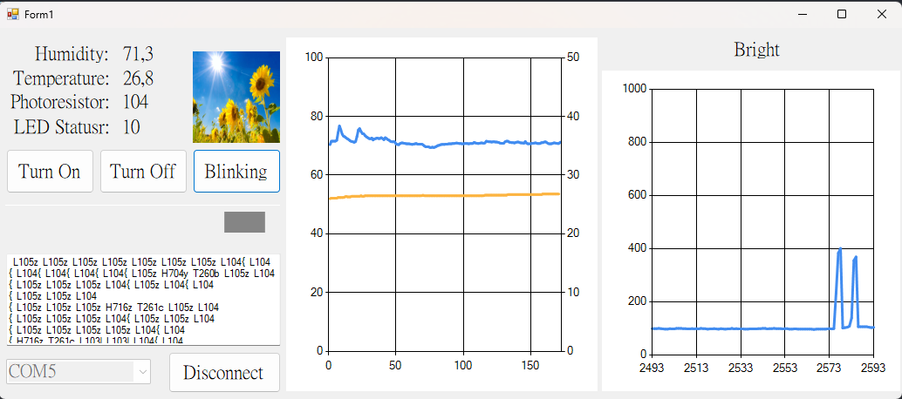
Test Photores Bright Condition
Indicator : image turn into sunny

Slide 12
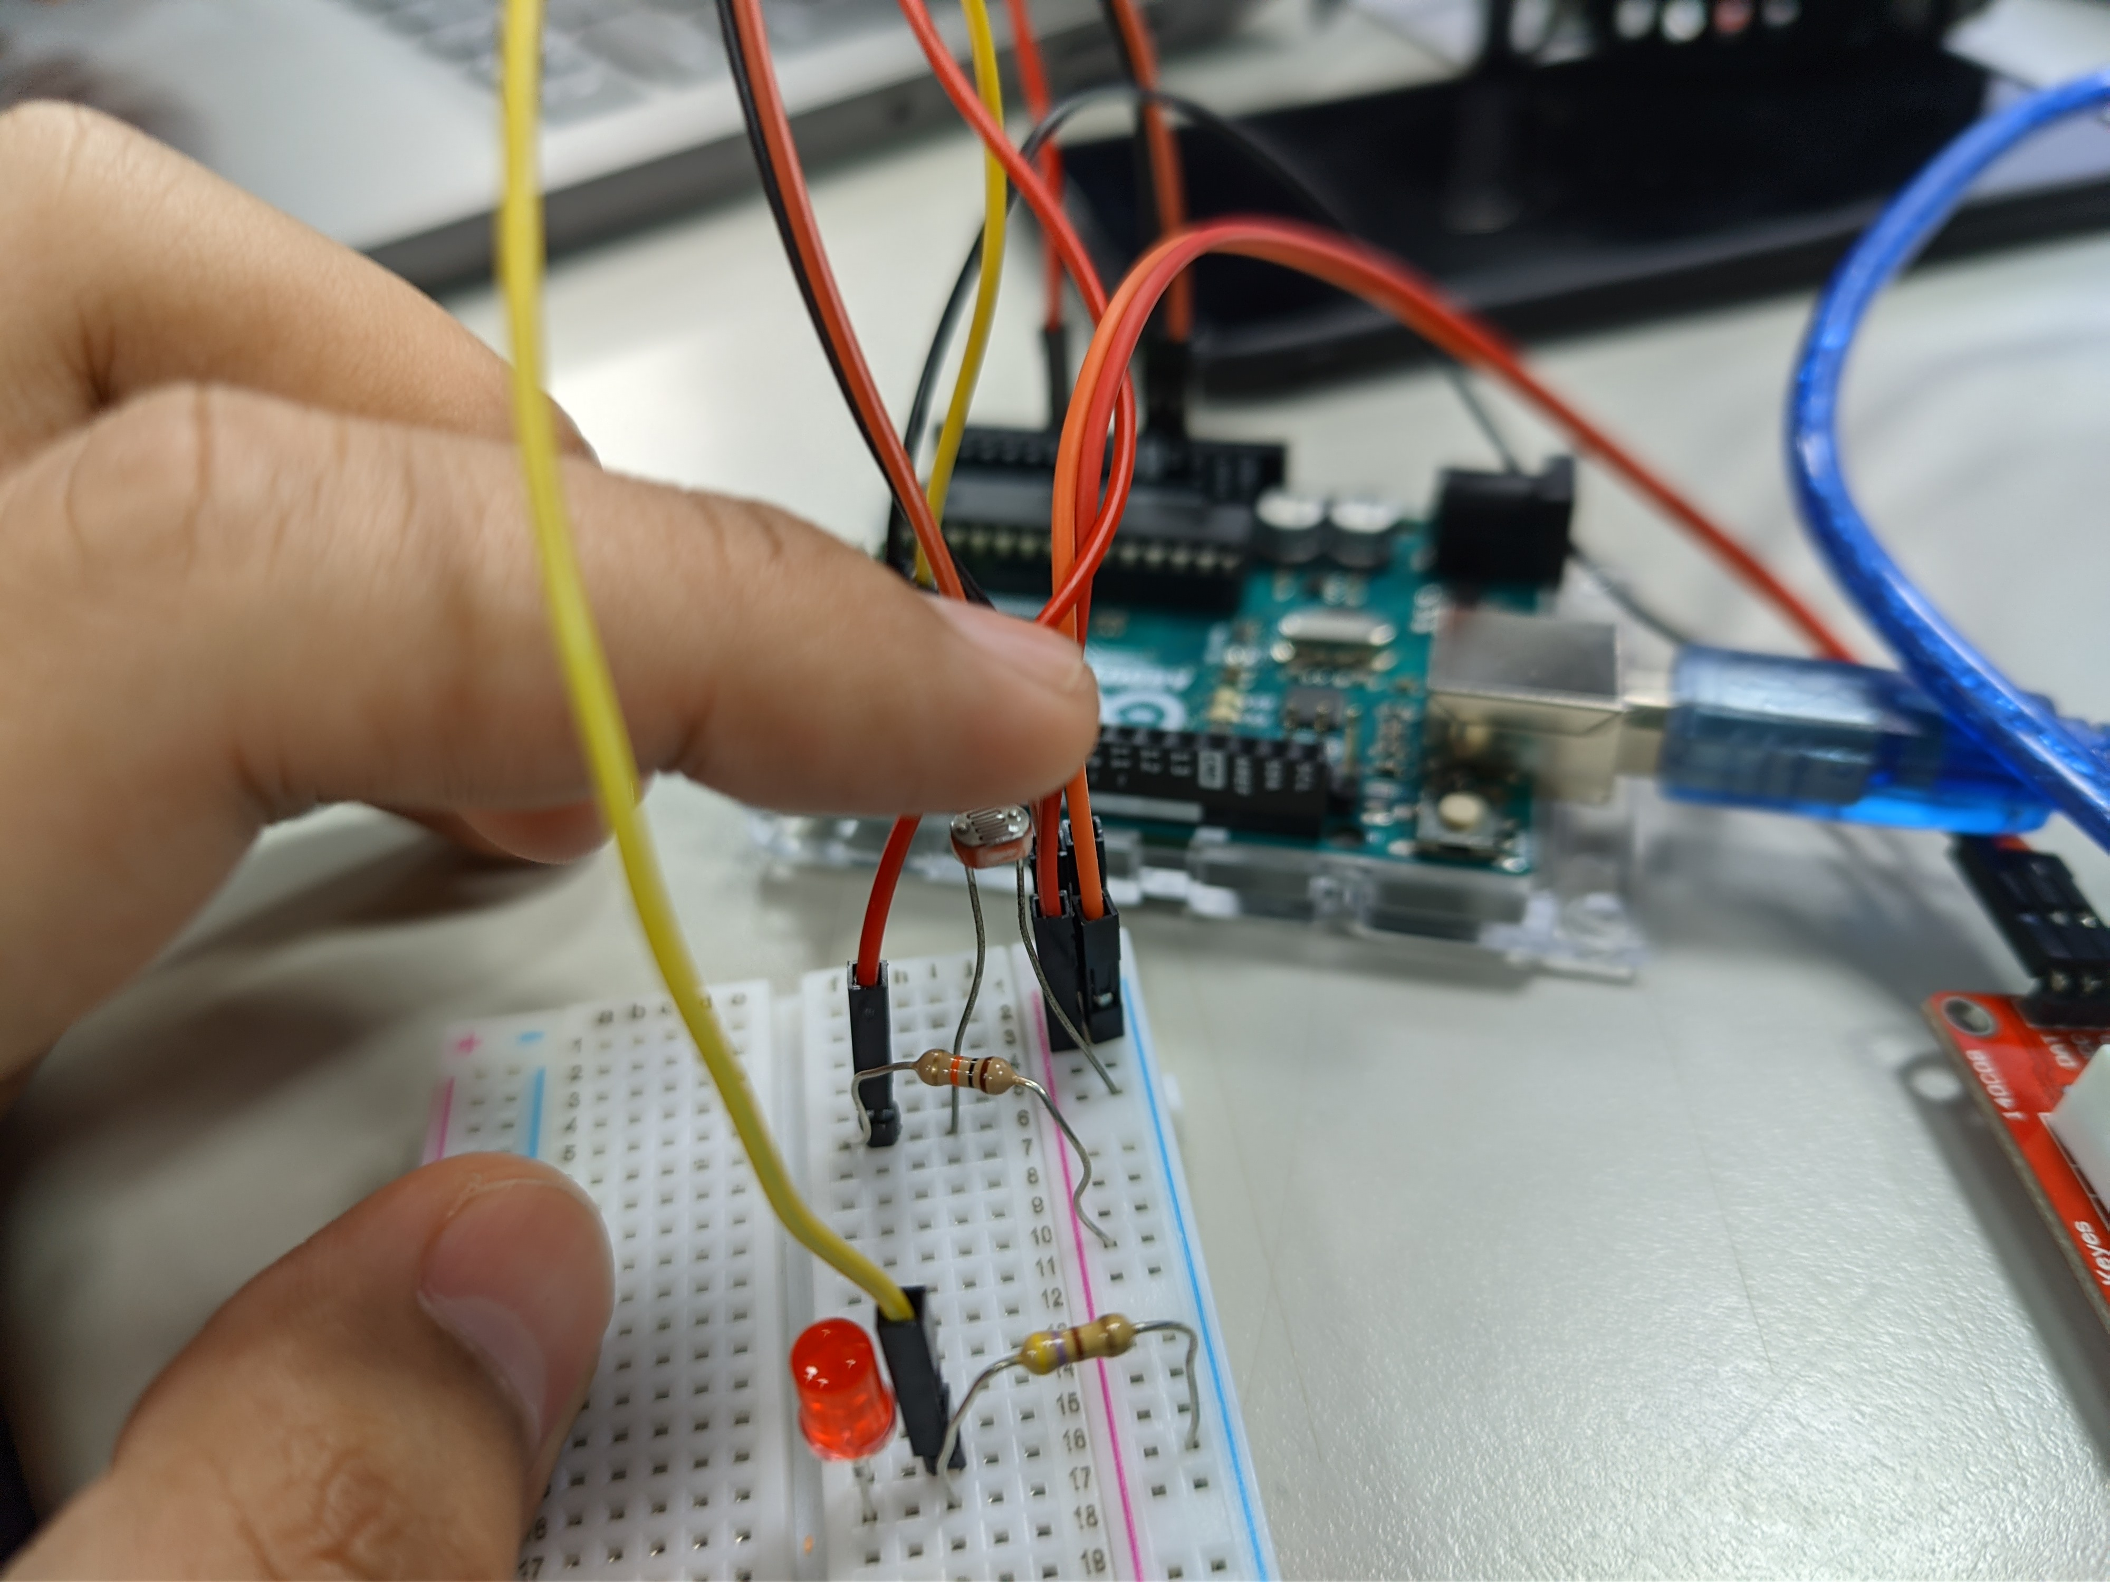
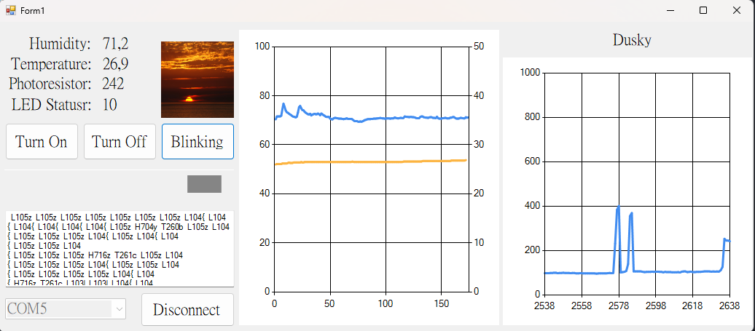
Test Photores Dim Condition
Indicator : image turn into sunset

Slide 13
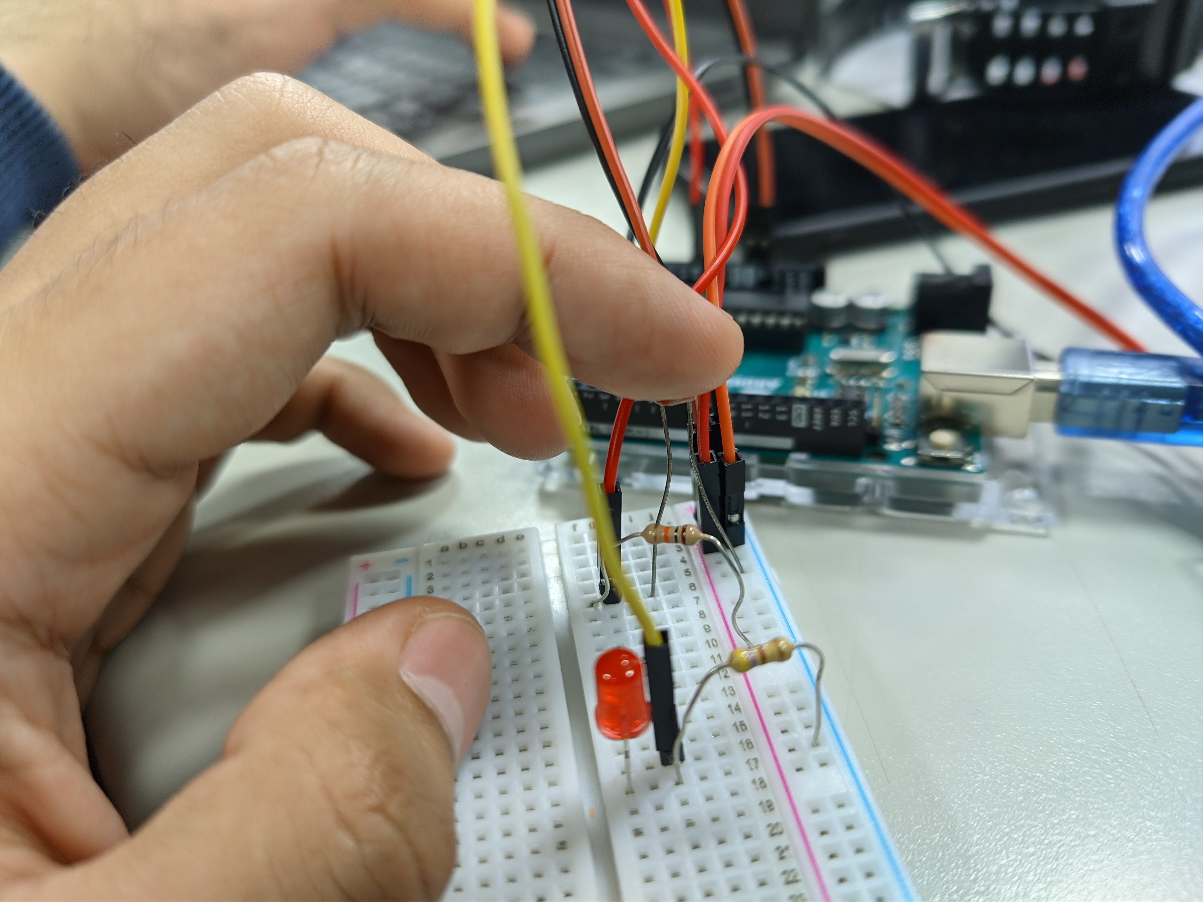
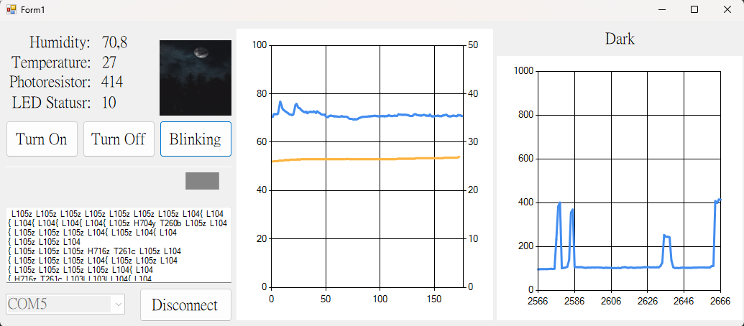
Test Photores dark Condition
Indicator : image turn into midnight

Slide 14
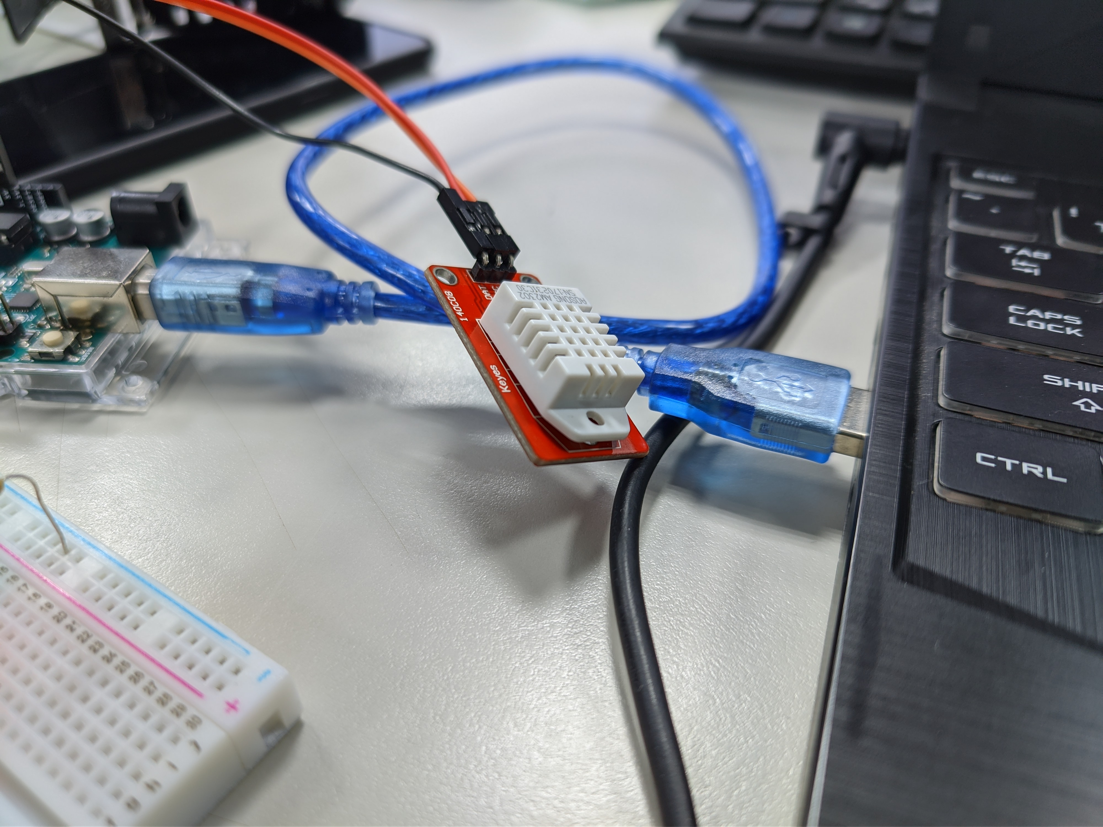
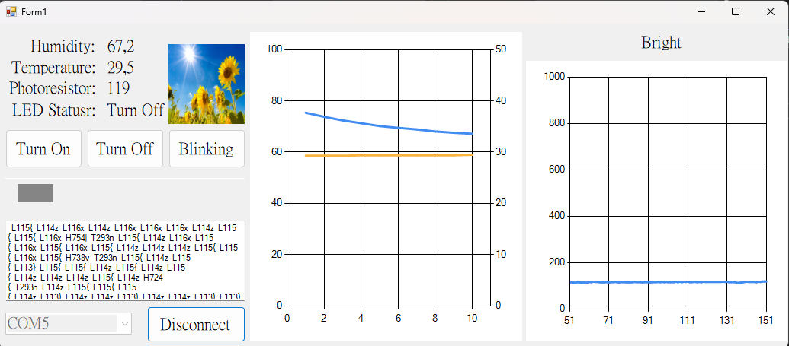
Test humidity and temperature dht open
Indicator : temp and humidity graph

Slide 15
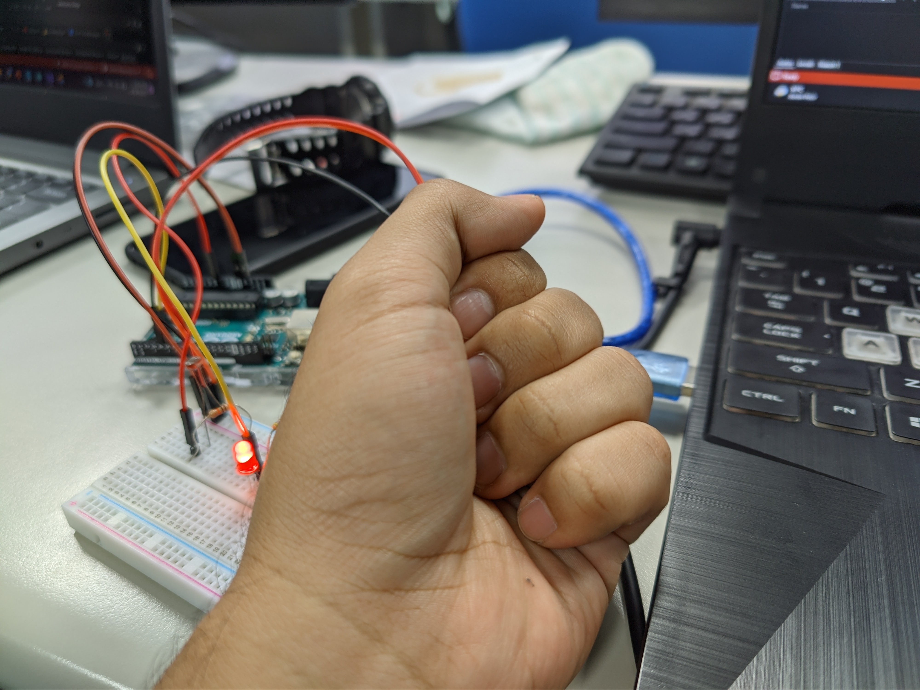

Test humidity and temperature dht closed
Indicator : temp and humidity graph increase

Slide 16
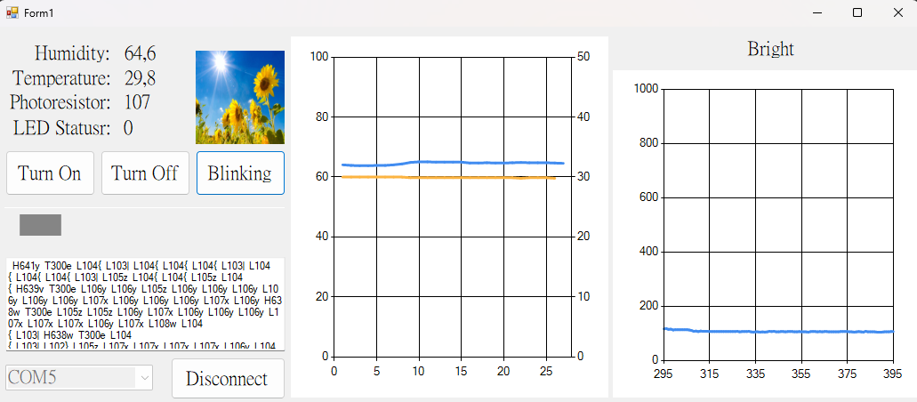
Test led off when slider max left
Indicator : led turns off

Slide 17
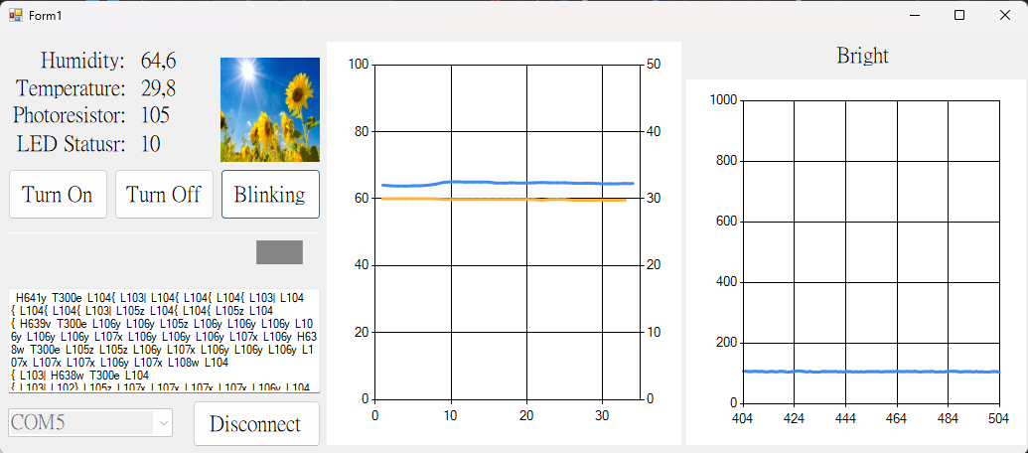
Test led on when slider max right
Indicator : led turns on

Slide 18

Success!
As you can see we manage to successfully and pass recreating the project and pass all the tests

Slide 19

Thank you

